Slide 1


Theory of Change (ToC) & Causal Inference
Muhammad Akmal Farouqi
17/3/2025
www.ugm.ac.id
Locally Rooted, Globally Respected

Slide 2
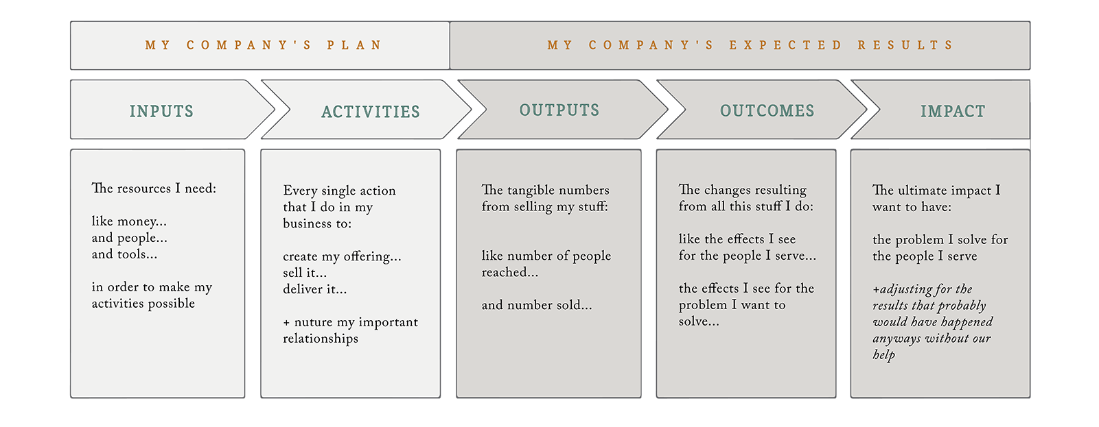
Theory of Change
Theory of Change is essentially a comprehensive description and illustration of how and why a desired change is expected to happen in a particular context. It is focused in particular on mapping out or “filling in” what has been described as the “missing middle” between what a program or change initiative does (its activities or interventions) and how these lead to desired goals being achieved.

Slide 3
Theory of Change: Implementation and Evaluation
ToC framework could help us answering these evaluation process’ questions
What is the treatment or intervention?
What are its intended and measurable outcomes?
how are the data to be collected and analyzed such that the causal links between treatments and outcomes are described in the most compelling way?
Stages of ToC’s implementation.
Identifying long-term goals
Backwards mapping and connecting the preconditions or requirements necessary to achieve that goal and explaining why these preconditions are necessary and sufficient.
Identifying your basic assumptions about the context.
Identifying the interventions that your initiative will perform to create your desired change.
Developing indicators to measure your outcomes to assess the performance of your initiative.
Writing a narrative to explain the logic of your initiative.
For more comprehensive discussion, please visit:
https://cnxus.org/wp-content/uploads/2022/04/08071320ApplyingTheoryofChangeApproach.pdf
https://www.theoryofchange.org/

Slide 4
What Is a Good Theory of Change?
It should be plausible. Do evidence and common sense suggest that the activities, if implemented, will lead to desired outcomes?
It should be doable. Will the economic, technical, political, institutional, and human resources be available to carry out the initiative?
It should be testable. Is the theory of change specific and complete enough for an evaluator to track its progress in credible and useful ways?
For more comprehensive discussion, please visit:
https://cnxus.org/wp-content/uploads/2022/04/08071320ApplyingTheoryofChangeApproach.pdf
https://www.theoryofchange.org/

Slide 5
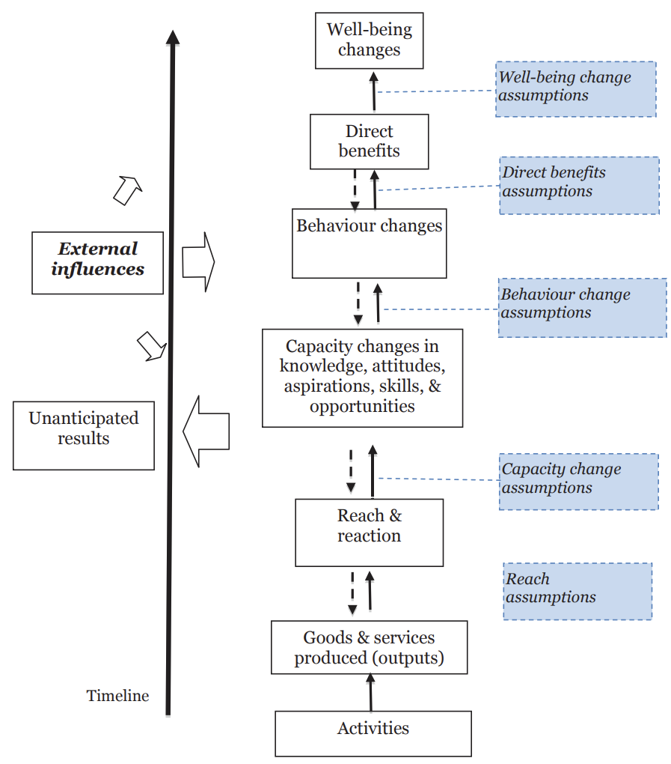
Theory of Change: Tahapan Program Menuju Dampak
Impact pathway
Sebuah program perlu memiliki alur logika kausalitas yang jelas dan terukur, mulai dari aktivitas (intervensi) sampai menerima dampak.
Hal ini diperlukan untuk mengetahui transmisi suatu program, secara teori maupun tinjauan literatur, hingga memberikan impact.
Tahapan-tahapan ini perlu diasumsikan terlebih dahulu untuk melihat rasionalisasi program terhadap target yang diharapkan (dalam hal ini adalah peningkatan kesejahteraan)
Selain itu, perlu diperhatikan risiko hasil yang tidak diharapkan pada setiap tahapan, baik disebabkan faktor internal maupun eksternal, yang mempengaruhi keberhasilan suatu program
“Useful Theory of Change” (Mayne, 2015)

Slide 6
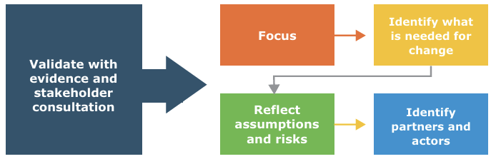
MOVING FROM THEORY TO PRACTICE (UNDAF Companion Guidance)
Key principles for developing a theory of change
It should be developed consultatively to all relevant stakeholders
It should be grounded in, tested with, and revised based on robust evidence
It should support continuous learning and improvement from program design to closure
Notes:
https://assets.publishing.service.gov.uk/media/57a08a66ed915d622c000703/Appendix_3_ToC_Examples.pdf

Slide 7
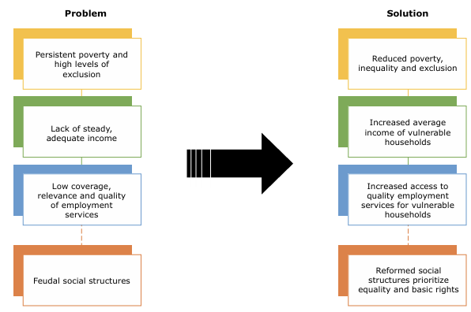
MOVING FROM THEORY TO PRACTICE (UNDAF Companion Guidance)
Selecting the high-level key development challenges that must be addressed based on a set of criteria; a) Equity, b) Comparative advantage, c) Feasibility
Change analysis:
→ Problem tree to Identify the immediate, underlying, and structural/root
→ Develop solution tree and identify expected solutions for each level of causality, to maintain the logical flow of solutions to achieve the desired change
Notes:
https://assets.publishing.service.gov.uk/media/57a08a66ed915d622c000703/Appendix_3_ToC_Examples.pdf

Slide 8
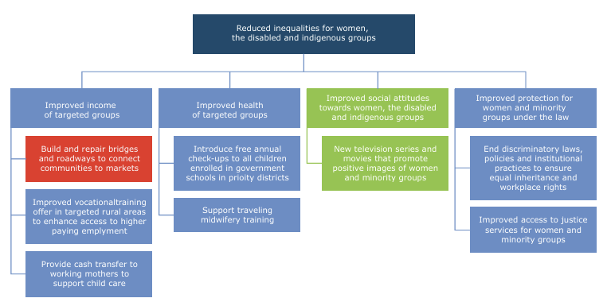
MOVING FROM THEORY TO PRACTICE (UNDAF Companion Guidance)
not addressed
Notes:
https://assets.publishing.service.gov.uk/media/57a08a66ed915d622c000703/Appendix_3_ToC_Examples.pdf

Slide 9
MOVING FROM THEORY TO PRACTICE (UNDAF Companion Guidance)
Selecting the high-level key development challenges that must be addressed based on a set of criteria; a) Equity, b) Comparative advantage, c) Feasibility
Change analysis:
→ Problem tree to Identify the immediate, underlying, and structural/root
→ Develop solution tree and identify expected solutions for each level of causality, to maintain the logical flow of solutions to achieve the desired change
Notes:
https://assets.publishing.service.gov.uk/media/57a08a66ed915d622c000703/Appendix_3_ToC_Examples.pdf

Slide 10
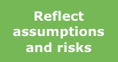

MOVING FROM THEORY TO PRACTICE (UNDAF Companion Guidance)
Assumption
Identify why solutions are the key drivers of change in a given context, and that may influence these drivers. (Causality, Implementation, External Factors).
For each assumption, it should consider
Does this fully explain what is thought will happen? Is the assumption plausible? Does the assumption need to be tested?
Risk Analysis
Environmental and political
Opportunities
Design
Partnership
Focus in particular on key actors likely to have a direct role in determining the success or failure of the change effort, and partners with whom we will work most directly to bring about change.
Notes:
https://assets.publishing.service.gov.uk/media/57a08a66ed915d622c000703/Appendix_3_ToC_Examples.pdf

Slide 11
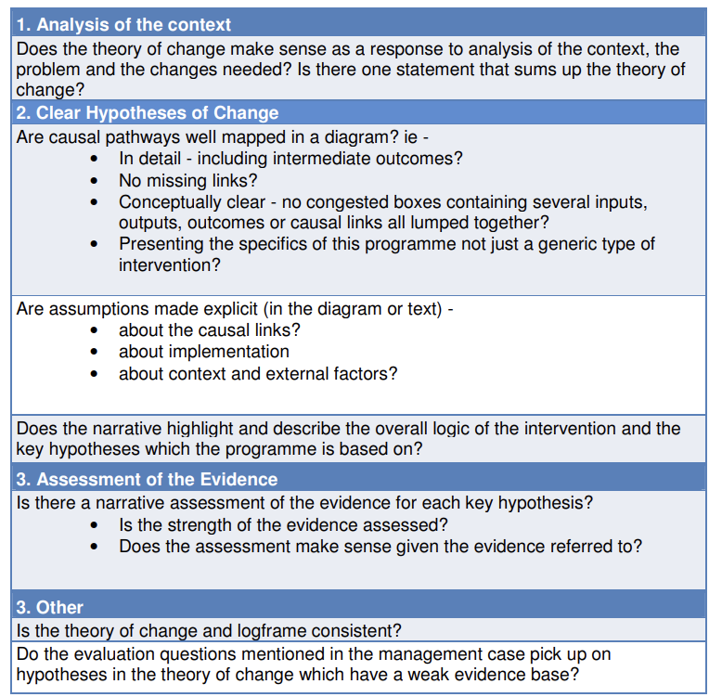
Evaluating Theory of Change
Notes:
‘

Slide 12
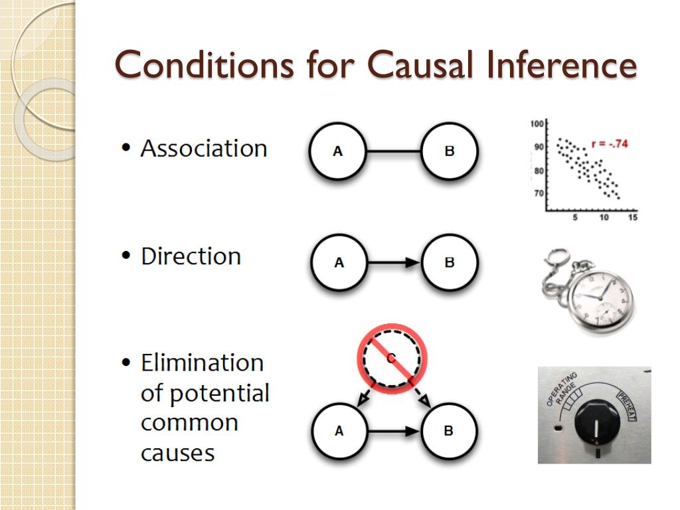
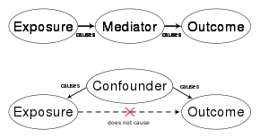
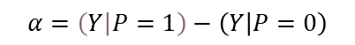
Causal Inference
Causal inference is the process of determining the independent, actual effect of a particular phenomenon.
Causal inference is a fundamental question when doing impact evaluation “does A really affect outcome B?”
$$α=\left(Y | P=1\right)−\left(Y | P=0\right)$$

Slide 13
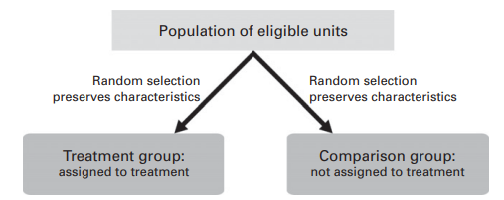
Causal Inference
A cause is something that makes a difference, and must be difference from what would have happened without it. Counterfactual is a common question when defining causal inference, which asked: “If A had not occurred, does C not occurred?”
Therefore, establish control group is important as a comparison on subject’s result when there is no intervention.

Slide 14
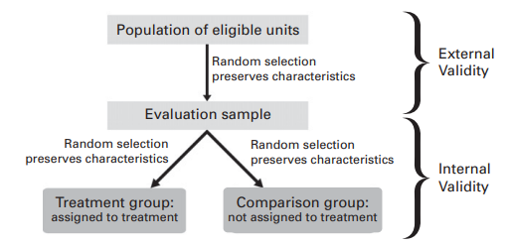
Causal Inference
The results from a study can be applied (generalized) to other situations, groups, or events.
degree of confidence that the causal relationship being tested is trustworthy and not influenced by other factors or variables
Experimental Design:
Quasi-Experimental Design:
Participants are randomly assigned
Using Control Group
Full control on the environment
Emphasizing internal validity
Non-randomly assigned (Using Existing Group)
Mostly not using Control Group
Full control might not possible
Emphasizing External validity

Slide 15
Example: Poorest States Inclusive Growth (PSIG)
Problem:
Access to financial services is seen as a critical factor in economic development. Microfinance, specifically, holds a potential to alleviate poverty through enhancement in income and employment opportunity, enabling them to participate and benefit from India’s economy. It seeks to improve the incomes, and reduce the vulnerability, of poor people and small producers, by expanding their access to finance and markets. But there is a lack of microfinance adoption for low-income customers.
Programme:
The program aimed at enhancing income and employment opportunities of the poor, especially women, in four poorest States of Bihar, MP, Odisha and UP by enabling the target group to participate and benefit from wider economic opportunities and growth. This program focused on two components: financial inclusion and impact investing. This evaluation will emphasize in the former.
It aims to widen the scope of available financial services beyond credit to include a full range of accessible financial services that support the needs of the poorest.
Notes:
https://beamexchange.org/to_pdf/?url=/evidence/evaluating-programmes/evaluating-psig/

Slide 16
Example: Methodology
The impact evaluation period will be multi year based on the programme’s ToC, incorporating indicators for outcomes and impacts for Household, institutional and sector level.
Household level:
Longitudinal panel survey ~4000 HHs.

Slide 17
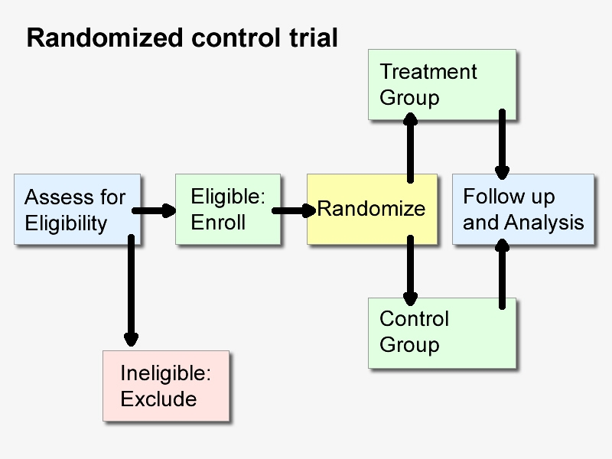
Randomized Controlled Trial
RCT is considered as the gold standard of experimental design (e.g policy evaluation)
Advantages of RCT
• Focus on identification of causal effects (across the board)
• Randomization
• Assessing External Validity
• Observing the Unobservables
• Data collection
• Iterative Experimentation
• Unpack impacts
Disadvantages of RCT
• Expensive
• Potential of loss to follow-up

Slide 18
Thank You

